Slide 1

Generative AI
Basic NLP concept
- Mickey

Slide 2
Agenda
NLP basic concept

Slide 3
Roadmap of Generative AI
Complicated Language Model
LLM: GTP, Hugging face
Advanced NLP concepts
RNN, LSTM RNN, GRU RNN
Bi-LSTM, Encoder Decoder, Attention,
Transformers
Deep learning concepts
ANN
Forward Propagation, Back propagation
Activation functions, Loss Fuctions
Basic ML NLP
Bag of words, TF-IDF, NGrams
Word2vec, stop words, lemmatization,
Stemming

Slide 4
Why NLP?
AI
Where is NLP ?
ML
DL

Slide 5
Preprocessing
Text preprocessing
Tokenization
Stop words
Stemming
Lemmatization
Word to vectors
One hot encoding
Bag of words
TF-IDF
Word2vec

Slide 6
Tokenization
Definition: to change sentence into words
Ex. Mickey likes to eat pizza.
=> Mickey, likes, to, eat, pizza

Slide 7
Stop words
Definition: the useless word (no meanings word)
Ex. Mickey likes to eat pizza.
He wish to go to your house.
Note: most of the NLP tools provides it’s own stop word database. (ex. NLPT)

Slide 8
Stemming
Definition: A process of reducing words into their base word skin
Ex.
Historical
Histor
History
Advantage:
Fast
Disadvantage:
It is removing the meaning of the word

Slide 9
Lemmatization
Definition: Transform the word into original format
Ex.
Historical
Finally
History
Final
Final
History
Finalize
Advantage:
We got the meaning of the word
Disadvantage:
It is slow

Slide 10
Agenda – NLP preprocessing
Basic Terminologies
One hot encoding
Bag of words
NGrams
TF-IDF
Word2vec

Slide 11
Basic terminologies
Corpus -> Paragraph
Documents -> Sentence
Vocabulary -> Unique words
Word -> separate word
The food is good.
The food is bad.
Pizza is amazing.
Burger is bad.

Slide 12
One hot encoding – 1/3
Example:
D1 = “A man eat food”
D2= “cat eat food”
D3= ”people watch video”
Vocabulary = [A, man, eat, food, cat, people, watch, video]
D1 = [[1,0,0,0,0,0,0,0], [0,1,0,0,0,0,0,0], [0,0,1,0,0,0,0,0], [0,0,0,1,0,0,0,0]]
D2 = [[0,0,0,0,1,0,0,0], [0,0,1,0,0,0,0,0], [0,0,0,1,0,0,0,0]]
D3 = [[0,0,0,0,0,1,0,0], [0,0,0,0,0,0,1,0], [0,0,0,0,0,0,0,1]]

Slide 13
One hot encoding – 2/3
Advantage | Disadvantage
簡單快速 直覺 | Features 會太多(會產生sparse matrix) 文集(corpus)中無法嵌入新字 資料長度不固定 無法取得語意(semantic meaning)

Slide 14
One hot encoding – 3/3
是否OHE就不適用?
在NLP裡面 OHE 因為會產生太多的維度, 故叫不適用,
但在離散資料的分類分群裡面時常會使用到OHE
Ex.
Defect 種類預測是否能報修
Panel id/ Defect type | Ｍura | 異物 | 破片 | 是否報廢
A0012 | 0 | 0 | 1 | 0
A0013 | 0 | 0 | 1 | 1
A0014 | 0 | 1 | 1 | 1
A0015 | 1 | 1 | 1 | 0

Slide 15
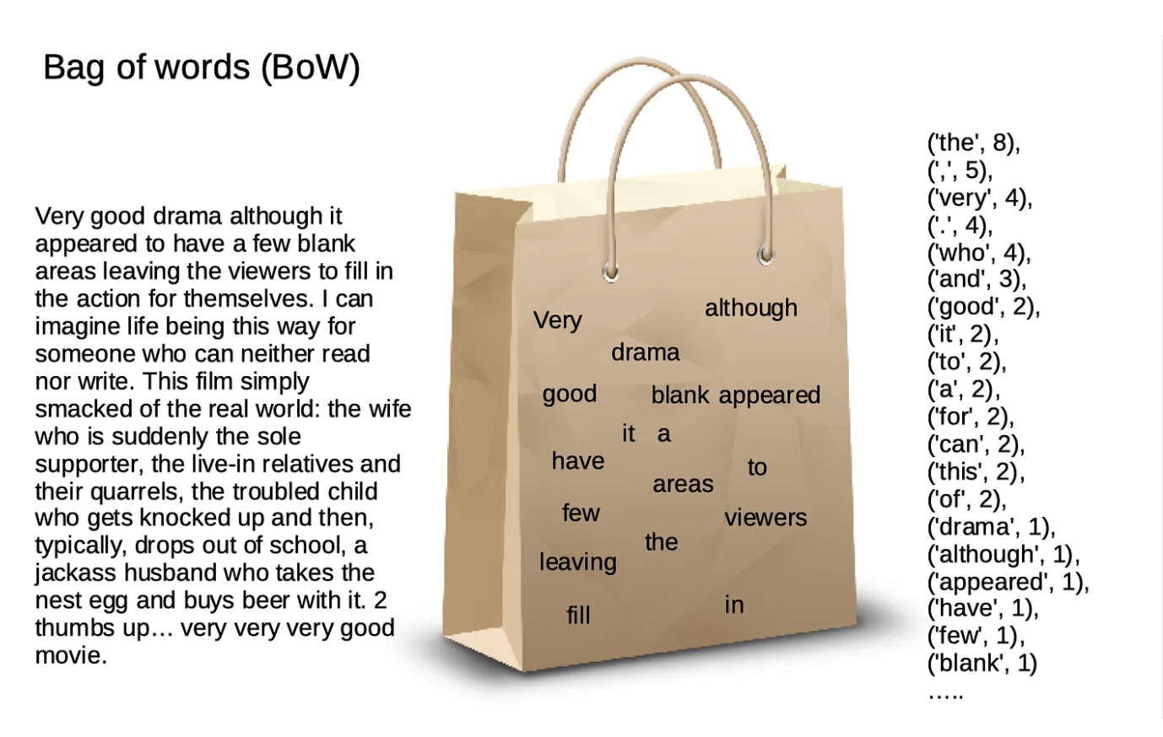
Bag of words – 1/4
就是改良版的OHE

Slide 16
Bag of words – 2/4
Example:
D1 = “He is a good boy”
D2 = “She is a good girl”
D3 = “Boy and girl are good”
[D1,D2,D3] => remove stop word + lower case
D1 = “he is a good boy” => good boy
D2 = “she is a good girl” => good girl
D3 = “boy and girl are good” => boy girl good

Slide 17
Bag of words – 3/4
D1 = “he is a good boy” => good boy
D2 = “she is a good girl” => good girl
D3 = “boy and girl are good” => boy girl good
Vocabulary: boy, girl, good
 | Feature1 (boy) | Feature2 (girl) | Feature2(good)
D1 | 1 | 0 | 1
D2 | 0 | 1 | 1
D3 | 1 | 1 | 1
Note: Binary BOW, 數量大於1, 一樣只給1

Slide 18
Bag of words – 4/4
Advantage | Disadvantage
簡單快速 直覺 | Features 會太多(會產生sparse matrix) 文集(corpus)中無法嵌入新字 文字順序會被異動 無法取得語意(semantic meaning)

Slide 19
N-gram – 1/5

Slide 20
TF-IDF – 1/5
 | Feature1 (boy) | Feature2 (girl) | Feature2(good)
D1 | 1 | 0 | 1
D2 | 0 | 1 | 1
D3 | 1 | 1 | 1
在BOW 裡面的資料皆利用count or binary來表達, 為了展現字詞本身的重要性與權重,
故以tf-idf 來表達字詞在整篇文集中的權重
Ex. The food is good
The food is not good

Slide 21

TF-IDF – 2/5
Ex. The food is good
The food is not good
cosine similarity = 4/ (2*$\sqrt{5}$) = 0.8
=> 但實際上, 這兩個句子的意思完全相反
 | The | food | Is | not | good
D1 | 1 | 1 | 1 | 0 | 1
D2 | 1 | 1 | 1 | 1 | 1

Slide 22
TF-IDF 1/3
TF: Term Frequency
IDF: Inverse Document Frequency
TF = numbers of repetition words in sentence / numbers of words in sentence
代表詞頻
IDF = log(numbers of sentence/ numbers of sentence includes the word)
代表該詞的獨特性
TF-IDF = TF * IDF (在該句中詞頻高, 且在整個文集獨特性高, 則權重高)

Slide 23
TF-IDF
D1 = “he is a good boy” => good boy
D2 = “she is a good girl” => good girl
D3 = “boy and girl are good” => boy girl good
Vocabulary: boy, girl, good
 | Feature1 (boy) | Feature2 (girl) | Feature2(good) | TF | IDF | TF-IDF
D1
D2
D3

Slide 24
TF-IDF
Advantage | Disadvantage
直覺 可以取得關鍵字的權重 | Features 會太多(會產生sparse matrix) 文集(corpus)中無法嵌入新字 無法取得語意(semantic meaning)

